Slide 1

Patent Landscape Analysis
AI-Driven Cybersecurity & Agentic AI
Dataset Overview: 635 patent publications | 29 corporate assignee groups | 11 jurisdictions | Filings 2023 – 2026
Source: IPCyberPatentWithAgenticAIExport | Prepared: July 2026
Notes:
Landscape of 635 AI-driven cybersecurity patent publications with agentic AI relevance, exported 30 June 2026. Coverage spans 29 consolidated assignee groups across 11 jurisdictions, application dates Jan 2023 through Feb 2026.

Slide 2
Executive Summary
AI-native cybersecurity patenting is accelerating sharply, led by six platform vendors
635
29
11
2023–26
10
176
Patent publications
Assignee groups (41 legal entities)
Jurisdictions (78% US)
Filing period (priorities to 2015)
Technology categories
Granted (27.7%)
Key findings
Filing volume grew from 220 applications in 2023 to 299 in 2024 (+36%); 2025–26 counts are understated only by the 18-month publication lag, indicating a sustained upcycle.
Zscaler (114), Microsoft (98) and Cisco (92) hold ~48% of the dataset; CrowdStrike is the fastest riser, nearly tripling annual filings from 14 (2023) to 41 (2024).
LLM & GenAI Security is the breakout category: filings jumped from 11 (2023) to 54 (2024), and 85.7% of its patents were filed in 2024 or later.
Detection remains the centre of gravity: Threat Detection & Behavioral Analytics (122 patents, 19.2%) and Network & Traffic Security (98, 15.4%) are the two largest categories.
Adversarial ML & Model Protection is nearly empty (4 patents, 0.6%) — a clear white-space filing opportunity as AI models themselves become the attack surface.
2
Notes:
Headline: 635 publications, 29 assignee groups, 78% US. Growth +36% YoY 2023→2024. Leaders Zscaler/Microsoft/Cisco ≈ half the dataset. LLM security is the breakout theme; adversarial ML protection is the largest white space.

Slide 3







Dataset Overview
One publication per record — no duplicate publication or application numbers detected
635
176
405
54
Total publications
Granted patents
Published applications
PCT applications
Distinct publication numbers; each record is a unique family member
US grants (170) plus EP B-publications (6); 27.7% of dataset
Pre-grant national/regional publications (63.8%)
WO publications pending national phase entry (8.5%)
Jan 2023
Feb 2026
484
AI × Cyber
Earliest application
Latest application
Forward citations
Technology scope
Earliest priority claim reaches back to Aug 2015 (continuations)
Recent filings under-represented due to publication lag
Received across 170 cited records; 9,399 backward citations
ML/LLM/agentic AI applied to detection, response, identity, network & cloud security
3
Notes:
Grant status derived from publication-number kind codes (US2… = pre-grant application). No inventor, legal-event or family columns exist in the export — flagged in the appendix.

Slide 4



Methodology
A five-step analytical pipeline applied to the full 635-record export
1. Data source
Patent-database export 'IPCyberPatentWithAgenticAIExport' (30 Jun 2026): 18 fields per record covering bibliography, abstract, first/independent claims, IPC/CPC codes and citation counts.
2. Cleaning & normalisation
Verified zero duplicate publication/application numbers; parsed dates; consolidated 41 legal entities into 29 corporate groups (e.g., IBM ×5 entities; Zscaler + Avalor; NVIDIA + Mellanox; SentinelOne + Sentinel Labs).
3. Categorisation
Rule-based taxonomy: every record scored against 10 category keyword sets over title (3× weight), abstract, first claim and CPC codes; highest score assigns the category; ML-generic residue mapped by CPC context.
4. Derived indicators
Legal status inferred from kind codes; filing recency (% filed 2024+), technology diversity, and citation intensity computed per assignee and per category.
5. Visualisation
Every chart is generated directly from the dataset; counts and percentages reconcile to the 635-record base. No external market data introduced.
4
Notes:
Emphasise assignee consolidation (41→29) and the weighted keyword taxonomy. Classification is deterministic and reproducible; category definitions are in the appendix.

Slide 5






Technology Taxonomy — 10 Categories
Derived from titles, abstracts, first claims and CPC codes of all 635 records
Threat Detection & Behavioral Analytics 122 patents (19.2%)
Network & Traffic Security 98 patents (15.4%)
ML/graph analytics detecting attacks, anomalies and user/entity behaviour (UEBA, XDR, SIEM)
Traffic inspection, firewalls, DNS analytics, intrusion prevention, SASE and SDN security
Security Policy, Posture & Platform Mgmt 81 patents (12.8%)
Identity, Access & Zero Trust 80 patents (12.6%)
Policy generation, posture control, configuration, orchestration and security platforms
Authentication, credentials, privileged access and zero-trust connectivity
LLM & GenAI Security 77 patents (12.1%)
Vulnerability, Risk & Exposure Mgmt 59 patents (9.3%)
Securing and using LLMs: prompt-injection defence, GenAI-assisted analysis, model guardrails
Vulnerability assessment, risk scoring, attack-surface and exposure management, pen-testing
Malware, Ransomware & Phishing Defense 45 patents (7.1%)
Agentic AI & SecOps Automation 39 patents (6.1%)
Malicious file/URL/email detection, ransomware mitigation, code-signature generation
AI agents, copilots and automated incident response / SOC workflow orchestration
Data, Cloud & Application Security 30 patents (4.7%)
Adversarial ML & Model Protection 4 patents (0.6%)
Data protection, encryption, cloud workload, CI/CD and application security
Defending AI models: adversarial attacks, poisoning, model provenance and assessment
5
Notes:
Ten categories; the four detection/network/policy/identity pillars account for 60% of the dataset. Adversarial ML at just 4 patents foreshadows the white-space discussion.

Slide 6
Technology Category Distribution
Detection and network security dominate; AI-model protection is nearly absent
Share of 635 patents
Threat Detection & Analytics | 19.2%
Network & Traffic Security | 15.4%
Policy, Posture & Platform | 12.8%
Identity & Zero Trust | 12.6%
LLM & GenAI Security | 12.1%
Vulnerability & Risk Mgmt | 9.3%
Malware & Phishing Defense | 7.1%
Agentic AI & SecOps | 6.1%
Data, Cloud & App Security | 4.7%
Adversarial ML Protection | 0.6%
6
Notes:
Top-4 categories (detection, network, policy, identity) = 381 patents = 60%. LLM & GenAI already 5th at 12.1% despite existing for barely two filing years.

Slide 7
Technology Category Share
A balanced core of six mid-size categories around two detection-centric anchors
Two anchors
Threat Detection & Analytics (19.2%) and Network & Traffic Security (15.4%) form over a third of the landscape — AI is being applied first where telemetry is richest.
635
Balanced middle
patents
Policy/Posture, Identity & Zero Trust, and LLM & GenAI Security each hold 12–13%, showing platform vendors patenting across the full security stack.
Thin tail
Agentic AI & SecOps (6.1%), Data/Cloud (4.7%) and Adversarial ML (0.6%) remain small — the newest concepts with the shortest filing history.
7
Notes:
Doughnut view of the same distribution; use the three call-outs to frame anchors vs balanced middle vs thin tail.

Slide 8

Technology Growth Trend
LLM & GenAI Security is the standout mover: 11 → 54 filings from 2023 to 2024 (+391%)
LLM security surge
The 2024 spike (54 filings) coincides with enterprise GenAI adoption; 85.7% of the category was filed 2024 or later.
Detection keeps compounding
Threat Detection & Analytics grew 36 → 49 and still leads in 2025 publications-to-date (36).
Identity cooling
Identity & Zero Trust fell from 42 (2023) to 28 (2024) — the one large category losing filing share.
*2025–26 understated by 18-month publication lag
8
Notes:
Six largest categories by application year. Headline: LLM security nearly quintupled 2023→2024. Identity/zero-trust is the only major category declining in absolute filings.

Slide 9
Patent Filing & Publication Trends
Applications up 36% YoY into 2024; grants are now flowing through at scale
+36%
Application growth 2023 → 2024 (220 → 299)
300
Publications peaked in 2025; 244 already in H1 2026
27.7%
Grant rate to date — rapid US allowance for AI-security claims
*Partial year; applications filed 2025–26 remain largely unpublished (18-month lag)
9
Notes:
Application curve (true demand signal) rose 220→299. Publication curve peaks 2025 as the 2023–24 cohort publishes. Grant curve: 13 grants published 2024, 80 in 2025, 81 already in 2026 — prosecution is moving fast.

Slide 10
Top 15 Patent Assignees
Six vendors above 45 patents each; the top three hold ~48% of the dataset
Zscaler — 114 (18.0%)
Includes Avalor (acquired 2024); zero-trust exchange and posture management core.
Microsoft — 98 (15.4%)
Broadest portfolio: 9 of 10 categories, strong Security-Copilot-era LLM filings.
Cisco — 92 (14.5%)
Detection + network security; includes Robust Intelligence AI-safety line.
Concentration
Top 3 = 304 patents (47.9%); top 6 = 486 (76.5%) — a highly consolidated field.
10
Notes:
Counts use consolidated corporate groups. Pure-play security vendors (Zscaler, PANW, CrowdStrike, Fortinet, Trend Micro, CyberArk, SentinelOne) collectively rival the hyperscalers.

Slide 11
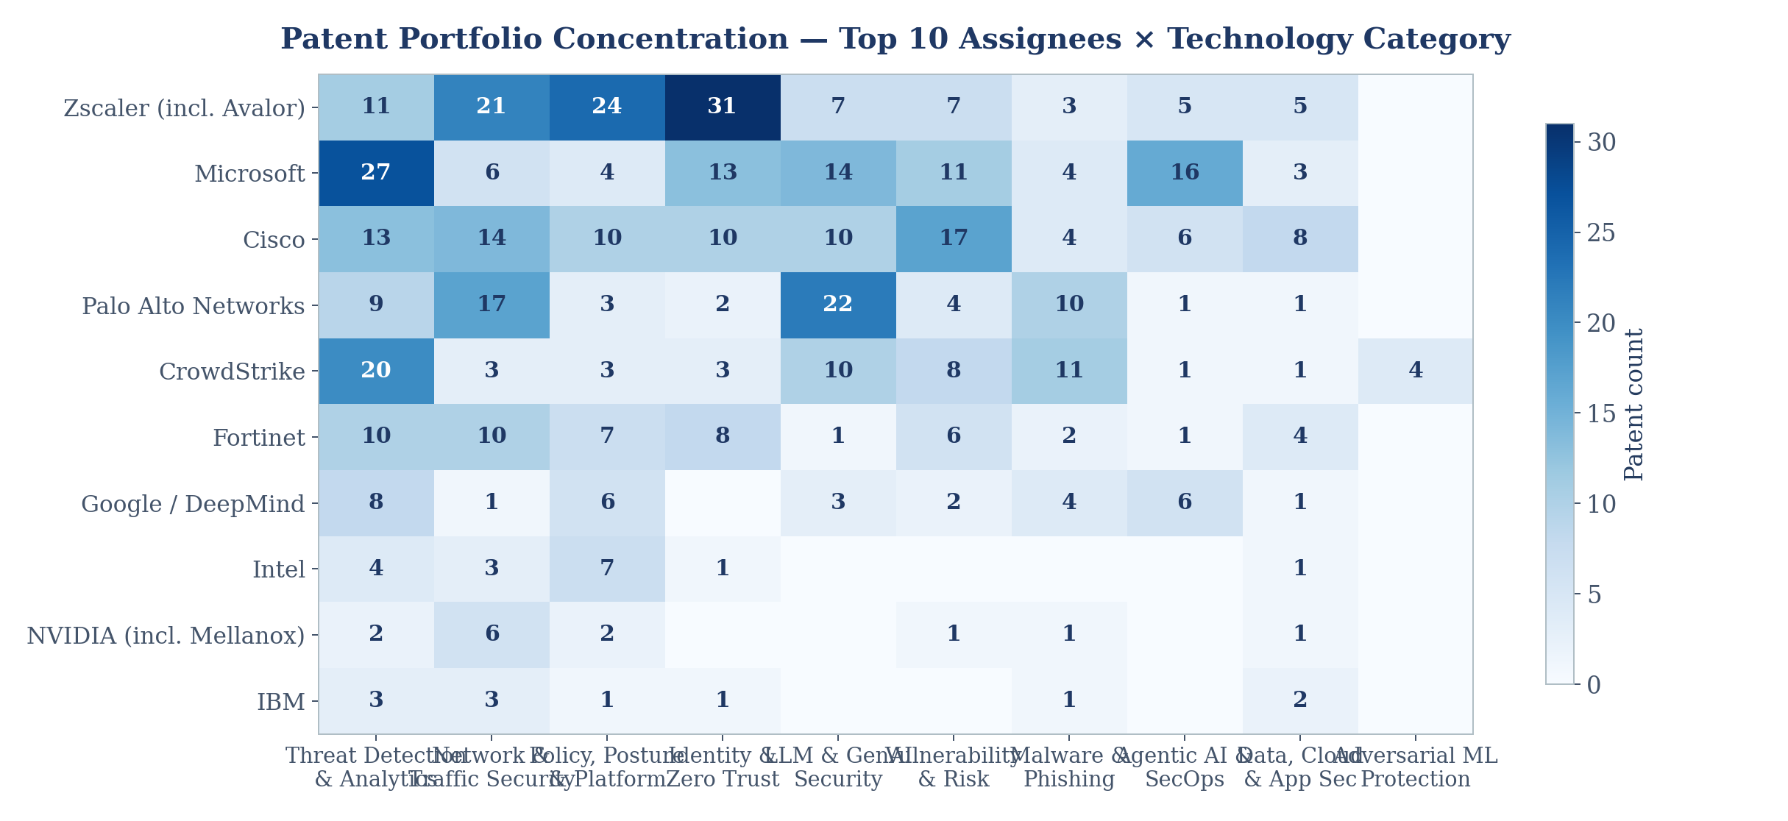
Assignee × Technology Concentration
Distinct strategic footprints: Zscaler in zero-trust/policy, Microsoft & Cisco in LLM security
11
Notes:
Read row-wise: Zscaler concentrated in identity/zero-trust (43) and policy/posture; Microsoft and Cisco lead LLM & GenAI security; CrowdStrike is the only top-10 assignee with adversarial-ML filings (4).

Slide 12


Geographic Distribution
A US-centric landscape: 78% of publications; international coverage remains thin
US first, often US only
496 of 635 publications (78.1%) are US filings — consistent with US-headquartered assignees protecting the home market first.
PCT pipeline
54 WO applications (8.5%) signal pending international expansion, mostly from Cisco, Microsoft and IBM.
Asia underweight
India (18), China (16), Japan (4) and Korea (4) combined are under 7% — foreign filing in growth markets is a visible gap.
12
Notes:
Publication venue analysis (one venue per record in this export). India shows 18 publications — notable for jurisdictional strategy discussions.

Slide 13
IPC / CPC Classification Analysis
H04L63 (network security) and G06F21 (platform security) dominate, fused with G06N (ML)
H04L63/1425 — Network monitoring & traffic analysis for intrusion detection — the single most-used code (153).
H04L63/1416 — Real-time attack detection by monitoring network events (123).
H04L63/20 — Management of network security policies (112).
H04L63/1433 — Vulnerability analysis / penetration assessment of networks (110).
G06F21/577 — Assessing vulnerabilities of a computing platform (87).
G06N20/00 — Machine learning per se — the AI backbone tag (87).
G06F21/552 / 554 — Local intrusion & anomaly detection via activity/event monitoring (66 / 85).
H04L63/1441 — Countermeasures and attack mitigation (61).
Subclass view: H04L (network security) leads 297 first-position records; G06F (computing security) 262; G06N (AI/ML) 27 — nearly every record pairs a security code with an ML code.
13
Notes:
CPC counts are occurrences across full code strings. The pairing pattern H04L63/G06F21 + G06N20 is the classification signature of this landscape.

Slide 14
Legal Status Overview
A young portfolio: nearly two-thirds still pre-grant, reflecting 2023–24 filing surge
405 Published applications (63.8%)
National/regional pre-grant publications under examination
176 Granted (27.7%)
170 US patents + 6 EP B-publications already enforceable
54 PCT applications (8.5%)
WO publications preserving worldwide filing options
Status inferred from publication kind codes; expired/withdrawn cases cannot be identified from this export.
14
Notes:
No legal-event data in the export, so status is kind-code derived. Expect the granted share to climb steeply through 2026-27 as the 2023-24 cohort prosecutes.

Slide 15
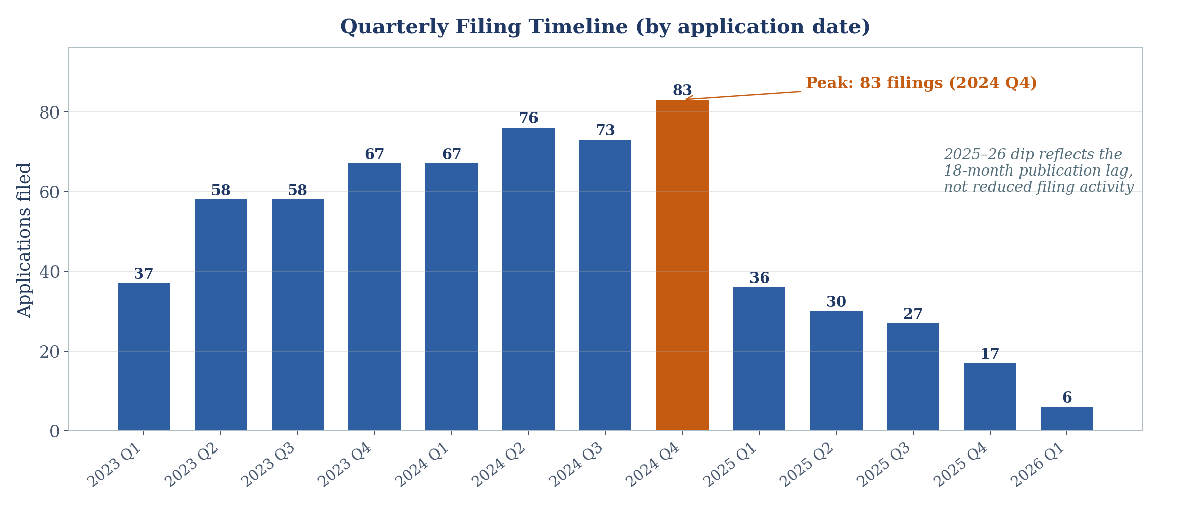
Quarterly Filing Timeline
Steady escalation through 2024 Q4 peak of 83 applications
Priority-date tail: 101 records claim priority before 2023 (earliest Aug 2015) — continuation chains carrying older invention dates into the current wave.
15
Notes:
Every quarter from 2023 Q1 to 2024 Q4 grew or held: 37→83. The post-2024 decline is a publication-lag artefact, not a demand signal.

Slide 16
Top Applicants Over Time
CrowdStrike nearly tripled filings into 2024; Zscaler led both 2023 and 2024
CrowdStrike +193%
14 → 41 applications 2023 → 2024 — the fastest organic growth among leaders.
Microsoft +50%
32 → 48; heaviest 2024 filer alongside Zscaler (49).
Cisco steady-state
38 → 37 → 16*; consistent volume with the largest 2025 pipeline visible so far.
*Partial-year data (publication lag)
16
Notes:
Six largest filers by application year. CrowdStrike's 2024 tripling is the single sharpest corporate acceleration in the dataset.

Slide 17
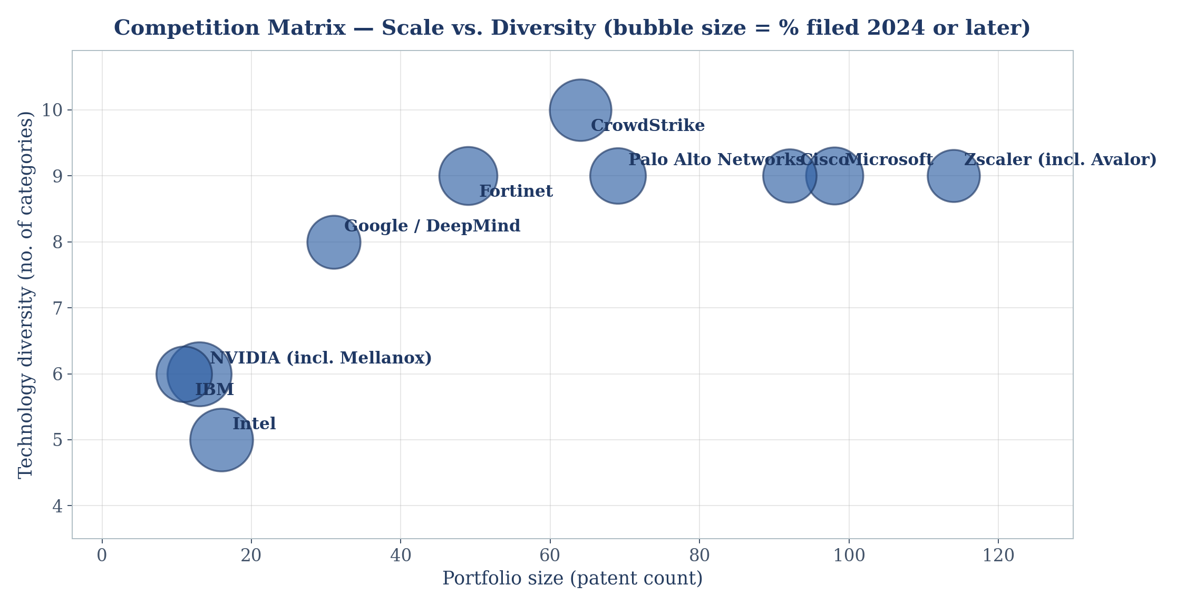
Company Competition Matrix
Scale vs. breadth: leaders combine 60+ patents with coverage of 9–10 categories
17
Notes:
X = portfolio size, Y = category diversity, bubble = share filed 2024+. CrowdStrike: highest recency (78%) and full 10-category coverage. Intel: small but 81% recent — a late, fast entrant.

Slide 18
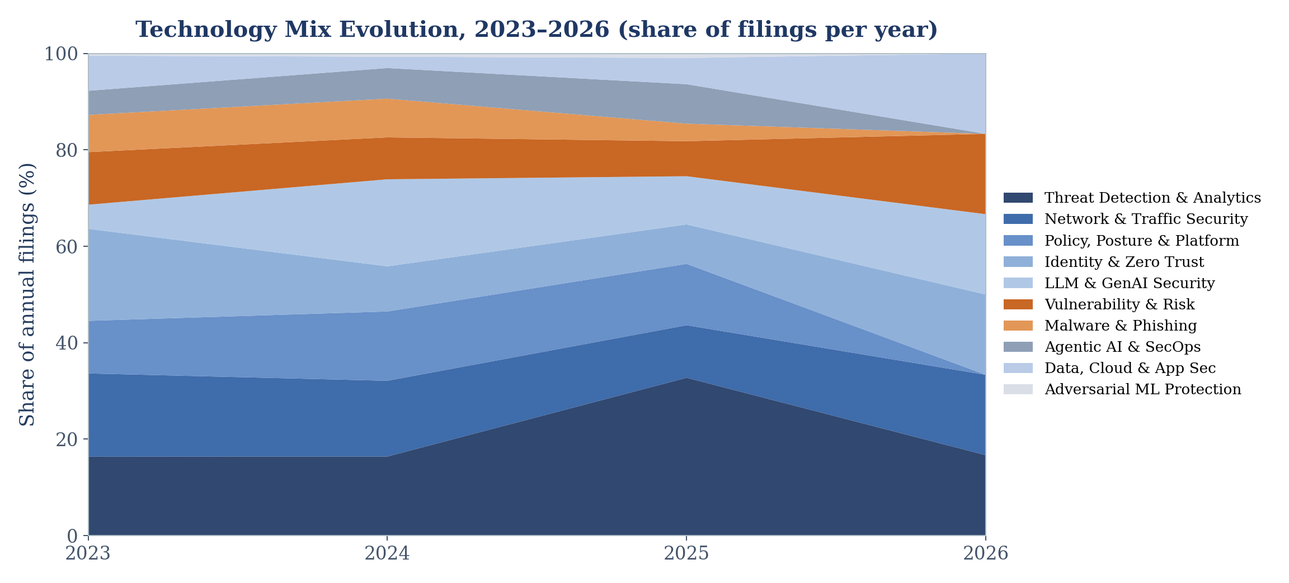
Technology Evolution, 2023 – 2026
The filing mix is rotating toward LLM security and detection analytics
LLM & GenAI Security grew from 5% of 2023 filings to 18% of 2024 filings; Identity & Zero Trust contracted from 19% to 9% over the same period.
18
Notes:
Stacked share view by application year. Story: GenAI displaces identity as the growth theme, while detection holds a stable ~17-33% band (2025 partial data skews detection up).

Slide 19
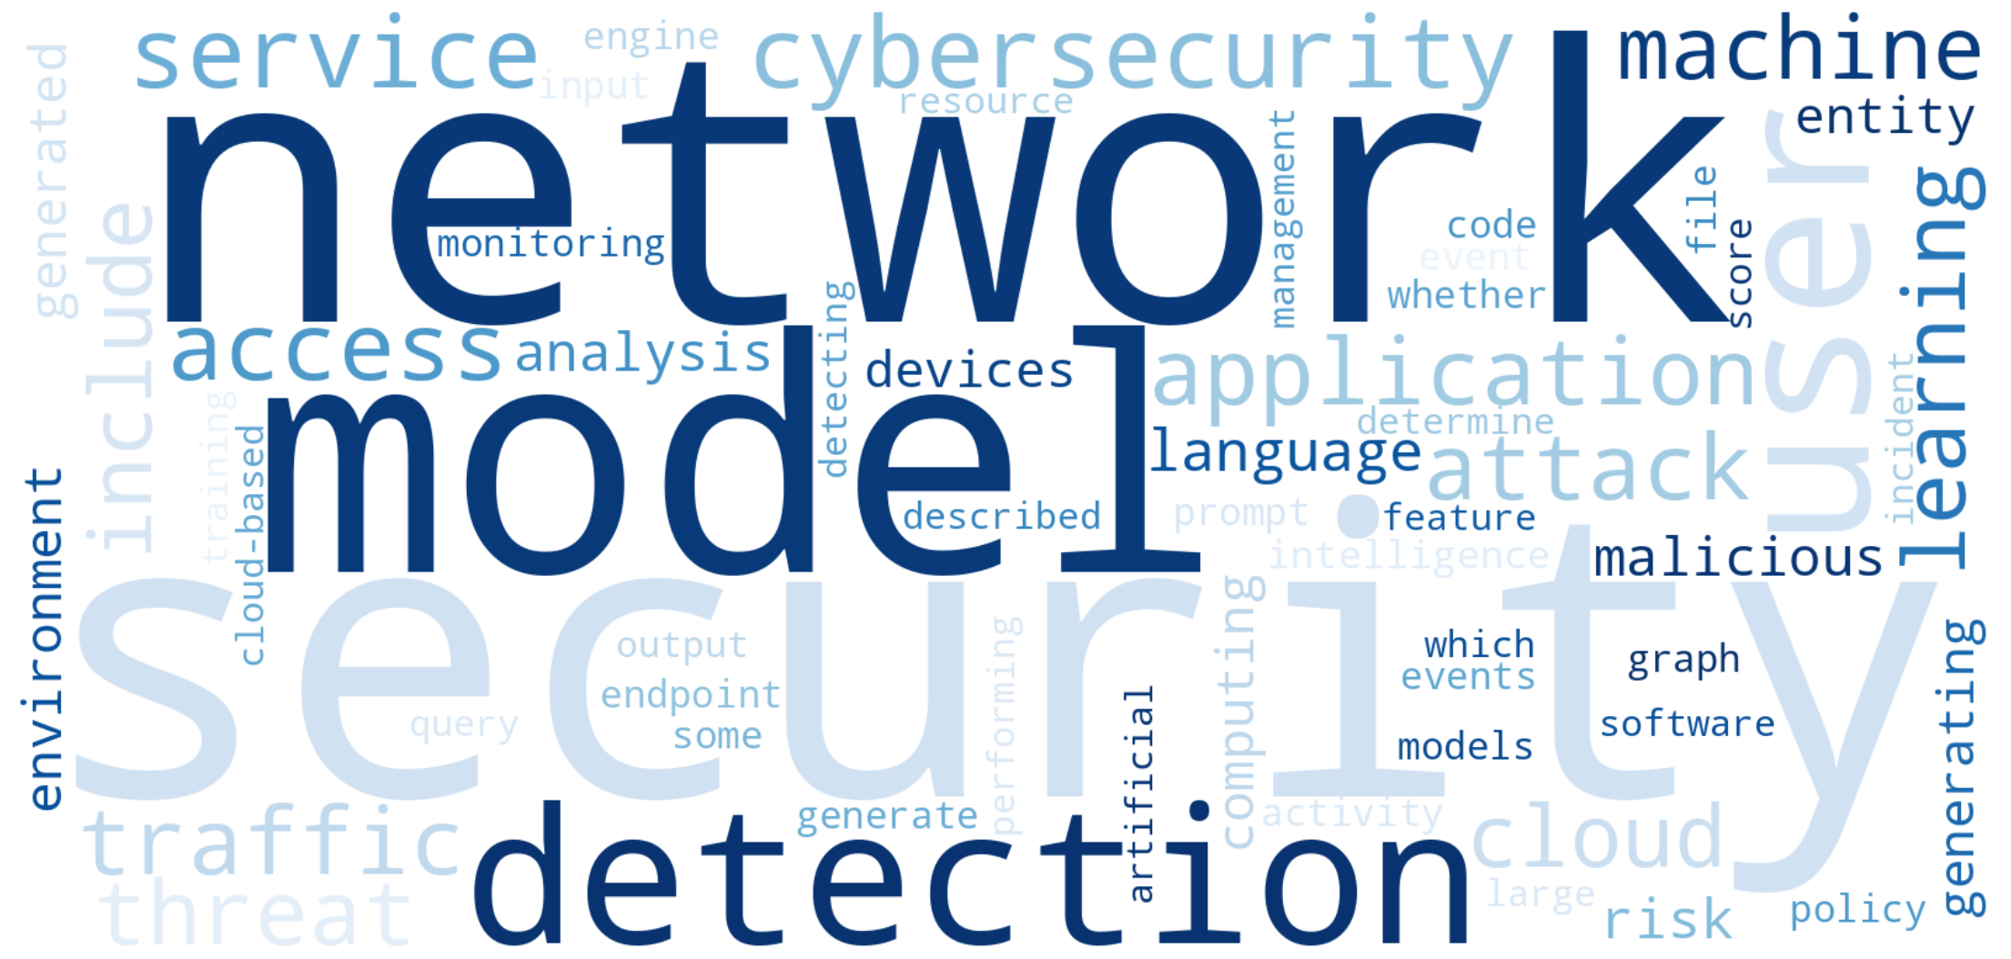
Keyword Analysis
'Machine learning' (157), 'artificial intelligence' (96) and 'large language model' pervade titles & abstracts
Top technical phrases
Phrase | Freq.
machine learning | 157
artificial intelligence | 96
network traffic | 90
learning model | 80
language model | 73
large language | 71
natural language | 63
computing environment | 50
risk score | 50
anomaly detection | 44
Vocabulary shift: 'large language model', 'natural language' and 'source code' now rank alongside classic terms like 'network traffic' and 'anomaly detection' — evidence that GenAI concepts have entered mainstream claim drafting. Full top-30 keyword table in the appendix.
19
Notes:
Word cloud from title+abstract term frequencies after stop-word removal. Bigram table shows GenAI vocabulary alongside traditional security terminology.

Slide 20
Emerging Technologies
Three themes show the filing acceleration and vocabulary growth of genuine emergence
LLM & GenAI Security 77 patents · 85.7% filed 2024+
Filings exploded from 11 (2023) to 54 (2024) — +391%. Covers prompt-injection defence, evasive-prompt detection, LLM-assisted triage and guardrails. 'Large language model' now appears 71+ times across abstracts. Every top-6 vendor is active; Palo Alto Networks (22) leads, ahead of Microsoft (14) and Cisco (10).
Agentic AI & SecOps Automation 39 patents · 71.8% filed 2024+
AI agents that investigate, decide and remediate autonomously: agent orchestration, copilots, automated incident response. Filings grew 11 → 19 into 2024. Early and unconsolidated — no vendor holds more than 9 — leaving room for foundational claims.
Adversarial ML & Model Protection 4 patents · 75% filed 2024+
Protecting the AI itself: adversarial-attack prevention (CyberArk), model provenance and AI/ML model assessment (CrowdStrike). CPC and keyword signals confirm demand, yet filing density is near zero — emergence at its earliest stage.
20
Notes:
Emergence criteria: filing acceleration (YoY growth), recency share, and keyword growth. The three tiers run from breakout (LLM) to forming (agentic) to nascent (adversarial ML).

Slide 21
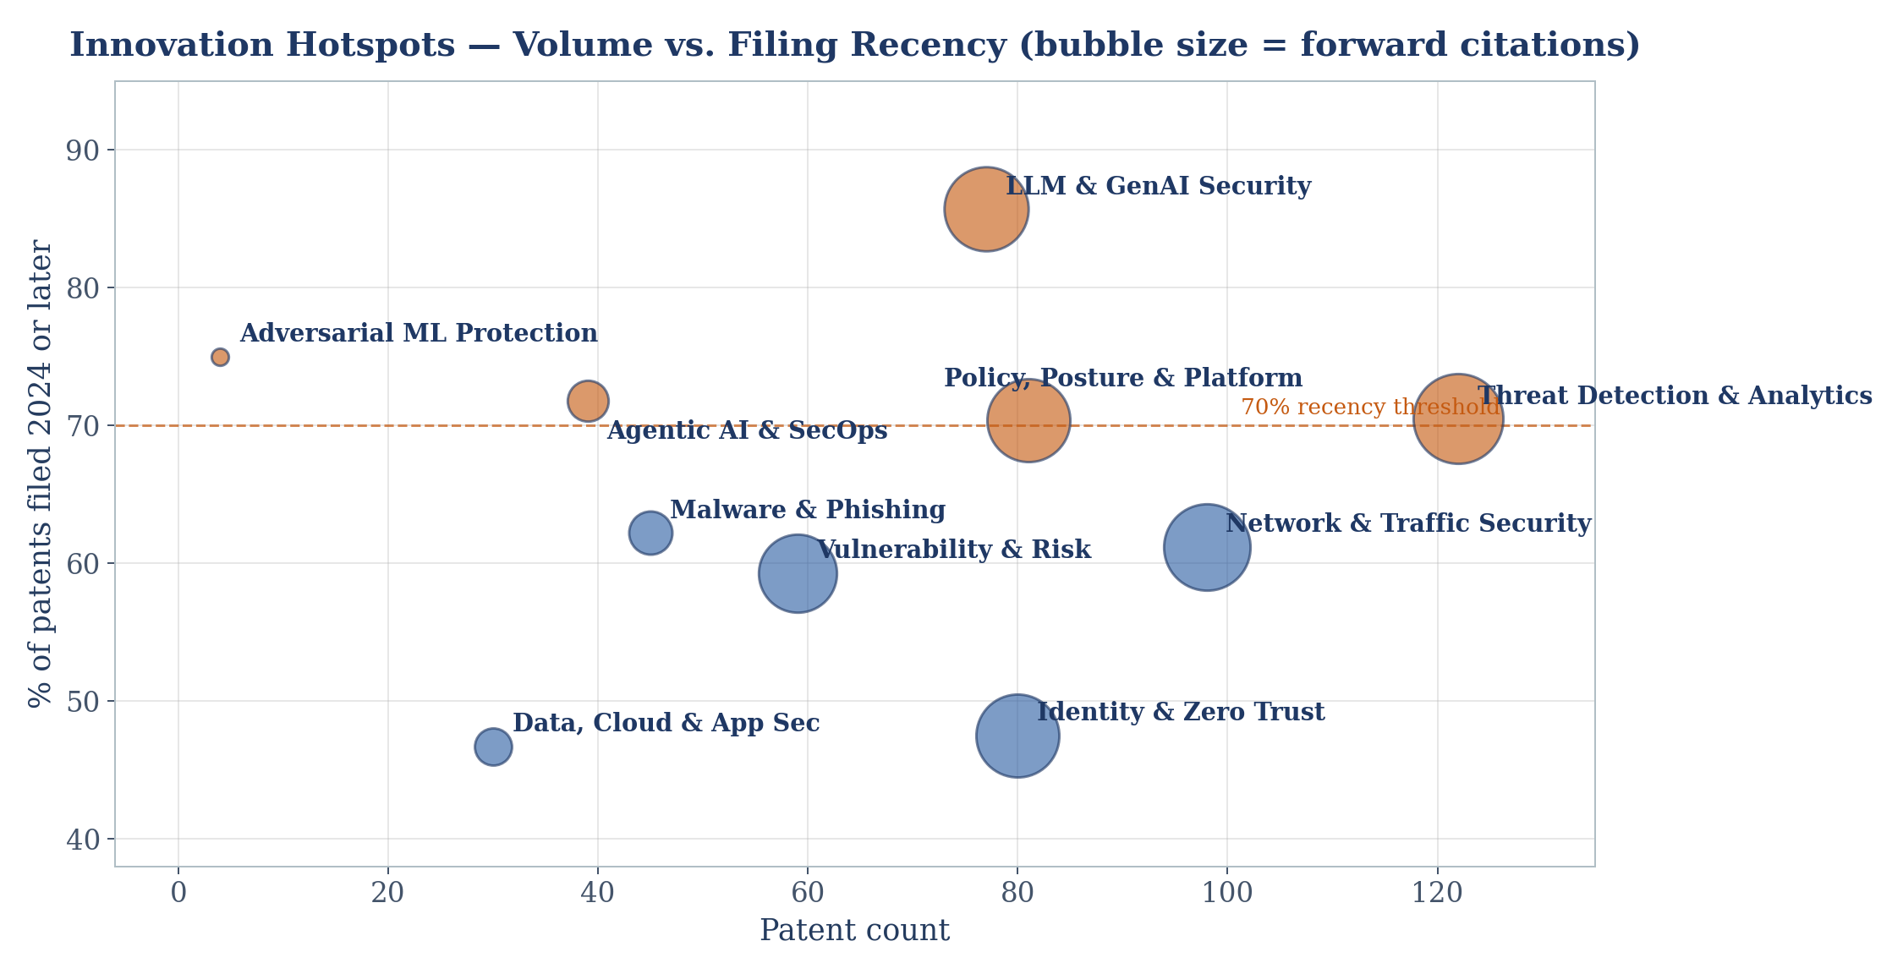
Innovation Hotspots
Volume × recency × citation impact identifies where R&D energy is concentrating
21
Notes:
Above the 70% recency line: LLM security, adversarial ML, agentic AI, detection analytics and policy/posture. Detection combines all three: highest volume (122), high recency (70.5%) and most forward citations (82).

Slide 22
White Space Analysis
Low patent density + rising demand = filing opportunity
Adversarial ML & Model Protection
4 patents (0.6%)
Agentic-AI Guardrails & Governance
Sub-segment of 39
AI models are becoming the attack surface (poisoning, evasion, theft), yet only CrowdStrike holds classified filings here. Foundational claims on model-integrity verification, poisoning detection and secure model supply chains remain available.
Agent patents cover orchestration and response, but almost none claim safety controls for the agents themselves — permissioning, action authorisation, rollback, audit of autonomous decisions. A predictable regulatory pull is unpatented.
AI Security for Data & Cloud Pipelines
30 patents, declining (16→7)
Non-US Jurisdictions
139 non-US publications (21.9%)
Data/cloud AI security filings halved 2023 → 2024 while CI/CD and model-training-data protection needs grew — competitors are looking elsewhere precisely where enterprise exposure is rising.
India (18) and China (16) coverage is minimal across all assignees. Whoever files AI-security claims in high-growth Asian markets faces limited blocking art from this cohort.
22
Notes:
Four white spaces: adversarial ML (near-zero density), agentic guardrails (unclaimed sub-domain), data/cloud AI pipelines (declining attention), and Asian jurisdictions (thin geographic coverage).

Slide 23
Patent Quality — Citation Analysis
Early but meaningful signal: 170 records already cited by later filings
US20240403437 (19 citations) — Cisco: External api vulnerability assessments
US20240244070 (14 citations) — VMware: Machine learning based network anomaly detection system
US20240291846 (11 citations) — Zscaler (incl. Avalor): Posture control for cloud environments
US20240129323 (11 citations) — Microsoft: Multitenant sharing anomaly cyberattack campaign detection
Portfolio-level view: 484 forward citations across the dataset; 26.8% of records already cited. Backward citations average 14.8 per record (9,399 total), indicating dense prior-art fields. Cisco's API-vulnerability filing (19 cites in ~3 years) is the early influence leader.
23
Notes:
Forward citations skew to 2023 filings (more time to accrue). Use as an influence proxy only; normalise by age for formal quality scoring.

Slide 24
Top 20 Important Patents (1 of 2)
Ranked by composite of forward citations, grant status and recency
No. | Publication | Title | Assignee | Filed | Category | Status | Cites
1 | US20240403437 | External api vulnerability assessments | Cisco | 2023 | Vulnerability & Risk Mgmt | Published | 19
2 | US20240244070 | Machine learning based network anomaly detection system | VMware | 2023 | Network & Traffic Security | Published | 14
3 | US12445474 | Attack path risk mitigation by a data platform | Fortinet | 2023 | Vulnerability & Risk Mgmt | Granted | 10
4 | US20240291846 | Posture control for cloud environments | Zscaler | 2023 | Policy, Posture & Platform | Published | 11
5 | US20240129323 | Multitenant sharing anomaly cyberattack campaign detection | Microsoft | 2023 | Threat Detection & Analytics | Published | 11
6 | US11876821 | Combined real-time and batch threat detection | Cisco | 2023 | Threat Detection & Analytics | Granted | 9
7 | US20250047701 | Asset security and risk posture visualization | Palo Alto Networks | 2023 | Policy, Posture & Platform | Published | 10
8 | US20240422198 | Systems and methods for providing zero trust access to source applications | Zscaler | 2023 | Identity & Zero Trust | Published | 10
9 | US20250317739 | Deep learning-based wireless intrusion detection | Cisco | 2025 | Network & Traffic Security | Published | 9
10 | US20240356918 | Reauthentication for zero trust WebSocket connections | Zscaler | 2023 | Identity & Zero Trust | Published | 9
24
Notes:
Composite score: forward citations ×3, grant bonus, recency bonus. First half dominated by 2023 filings that have accrued citations.

Slide 25
Top 20 Important Patents (2 of 2)
Granted status and citation momentum among 2023–24 filings
No. | Publication | Title | Assignee | Filed | Category | Status | Cites
11 | US20250039235 | Ai-based honeypot to mitigate social engineering cyberattack | Cisco | 2023 | Threat Detection & Analytics | Published | 9
12 | US20240386098 | Application server protection by maintaining cross-session inspection context | Zscaler | 2023 | Policy, Posture & Platform | Published | 9
13 | US20240323189 | Policy based authentication for Privileged Remote Access (PRA) systems | Zscaler | 2023 | Identity & Zero Trust | Published | 9
14 | US20250133120 | Security policy framework for cloud environments | Zscaler | 2023 | Policy, Posture & Platform | Published | 9
15 | US20250181836 | Systems and methods for jailbreaking black-box large language models | Robust Intelligence Inc | 2024 | LLM & GenAI Security | Published | 8
16 | US11811855 | Policy based agentless file transfer in zero trust private networks | Zscaler | 2023 | Identity & Zero Trust | Granted | 6
17 | US20250280027 | Security rating & incident risk scoring for attack surface management | Palo Alto Networks | 2024 | Vulnerability & Risk Mgmt | Published | 7
18 | US20250335795 | Unstructured data extraction with large language models for query resolution | Palo Alto Networks | 2024 | LLM & GenAI Security | Published | 7
19 | US20250159024 | Systems and methods for abnormal Classless Inter-Domain Routing (CIDR) access detection | Zscaler | 2023 | Network & Traffic Security | Published | 7
20 | US12074906 | System and method for ransomware early detection using a security appliance as default… | Zscaler | 2023 | Network & Traffic Security | Granted | 5
25
Notes:
Second half includes granted assets with early citations — candidates for claim-chart review in any FTO or licensing exercise.

Slide 26

Company Strategy Analysis
Four strategic postures visible in the filing data
Leaders
Zscaler · Microsoft · Cisco
Challengers
Palo Alto Networks · CrowdStrike · Fortinet
48% of the dataset. Zscaler concentrates on zero-trust/posture (platform moat); Microsoft files broadly across 9 categories with the deepest LLM-security bench; Cisco pairs network detection with acquired AI-safety capability (Robust Intelligence).
45–69 patents each. CrowdStrike is the fastest-growing filer (+193% into 2024) and the only top-10 assignee covering all 10 categories, including adversarial ML. PANW emphasises posture visualisation; Fortinet holds cited attack-path assets.
Focused specialists
CyberArk · Okta · SentinelOne · Trend Micro
Infrastructure entrants
Intel · NVIDIA · Qualcomm · Arm · Google
Narrow, deep portfolios: CyberArk's adversarial-LLM defence (16 backward cites, already cited), Okta in identity, SentinelOne in autonomous endpoint response. Attractive licensing or acquisition targets.
Chip and cloud platforms securing the AI stack itself. Intel: 81% of filings 2024+, the latest fast entrant. Google/DeepMind spread across 8 categories at moderate volume.
26
Notes:
Postures derived from volume, growth, diversity and category mix. CrowdStrike is the swing player: challenger volume with leader-grade breadth and the highest recency.

Slide 27
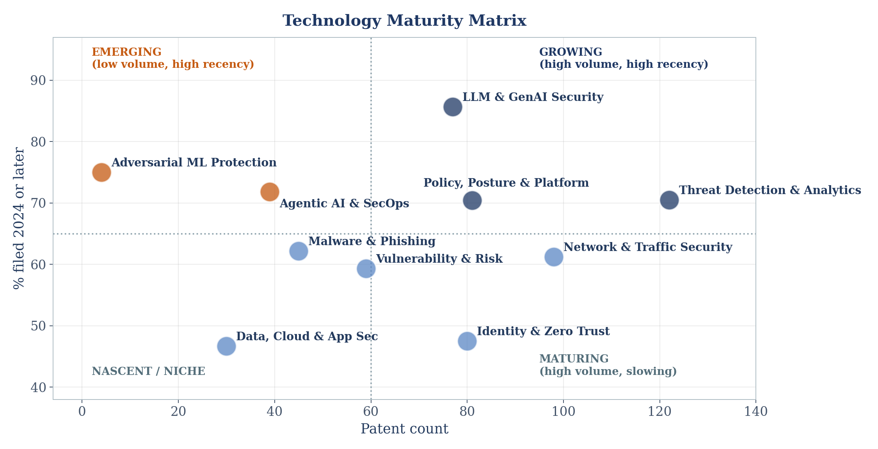
Technology Maturity
Positioning each category by volume and filing recency
Emerging
LLM & GenAI Security · Adversarial ML · Agentic AI
Growing
Threat Detection & Analytics · Policy, Posture & Platform
Maturing
Network & Traffic Security · Malware & Phishing · Vulnerability & Risk
Established
Reasoning: 'recency' (share of patents filed 2024+) proxies acceleration; volume proxies accumulated investment. Identity & Zero Trust shows classic saturation — the largest 2023 base (42 filings) declining fastest.
Identity & Zero Trust · Data, Cloud & App Security (recency < 50%)
27
Notes:
Quadrant model: recency vs volume. Emerging = low volume/high recency; Growing = high/high; Maturing = high volume with mid recency; Established/saturated = recency below 50%.

Slide 28
Competitive Landscape — Leading Vendors Compared
Strengths and exposures of the four largest portfolios
Zscaler (incl. Avalor) 114 patents
Microsoft 98 patents
S: Deepest zero-trust/posture moat (31 identity + 24 policy); Avalor adds risk-data fabric.
W: Minimal LLM-security presence (4) and no adversarial-ML filings; 78% US-only exposure.
S: Broadest spread (9 categories); LLM-security leader (21); strong PCT/EP usage for global reach.
W: Less concentrated depth per category; detection volume trails Cisco and Zscaler.
Cisco 92 patents
CrowdStrike 64 patents
S: Detection + network core; most-cited patent in dataset (19 cites); Robust Intelligence AI-safety line.
W: 2024 filings flat (38→37) while rivals accelerated; light identity coverage.
S: Fastest growth (+193%); only vendor in all 10 categories; unique adversarial-ML position (4).
W: Smaller absolute base; portfolio too young for citation influence (grant share below peers).
28
Notes:
S/W drawn strictly from dataset evidence: category mixes, growth rates, citations and jurisdiction spread. Green = strengths, red = weaknesses/exposures.

Slide 29

Key Findings
Six takeaways from the 635-patent landscape
Structural growth
Consolidated leadership
GenAI rotation
Applications rose 36% into 2024 (220→299); the quarterly series climbed every period to the 2024 Q4 peak of 83 — AI-security patenting is in a sustained upcycle.
Three vendors hold ~48% and six hold ~77% of all publications; new entrants face a dense, concentrated art field.
LLM & GenAI Security grew from 5% to 18% of annual filings in one year, while Identity & Zero Trust contracted from 19% to 9% — the growth theme has rotated.
Fastest movers
Geographic asymmetry
Open flank
CrowdStrike (+193% filings, 10/10 categories) and Intel (81% of portfolio filed 2024+) are repositioning most aggressively.
78% of publications are US; India + China + Japan + Korea together are under 7% — global enforcement coverage lags innovation.
Adversarial ML & model protection holds 4 patents against clearly rising need — the most actionable white space identified.
29
Notes:
Six findings: growth, concentration, GenAI rotation, fast movers, US-centricity, and the adversarial-ML white space.

Slide 30


Recommendations
Actions across R&D, filing strategy and corporate development
R&D priorities
White-space filing
Direct research toward adversarial-ML defence and agentic-AI guardrails (authorisation, audit, rollback of autonomous actions) — categories where technical need is confirmed but claim density is minimal.
File early, broad claims in model-integrity verification, poisoning detection and agent-governance controls before the 2024–25 application cohort publishes and closes the window.
Geographic strategy
Licensing opportunities
Extend priority filings into India and China via PCT national phase; only 34 combined publications exist there from this entire cohort, limiting blocking risk.
Highly cited 2023 assets (Cisco US20240403437, VMware US20240244070, Fortinet US12445474) anchor licensing conversations in API security, network anomaly detection and attack-path analytics.
Collaboration & monitoring
Acquisition screening
Track CrowdStrike (fastest growth, broadest coverage) and Intel (late surge) quarterly; partner with focused specialists (CyberArk, SentinelOne) whose deep-but-narrow portfolios complement platform gaps.
The Avalor→Zscaler and Robust Intelligence→Cisco patterns show IP-led M&A in this space; screen small assignees (Threatology, Zilla Security, Zimperium) whose filings sit in emerging categories.
30
Notes:
Six recommendation lanes. Emphasise timing on white-space filing: the unpublished 2025-26 pipeline means windows close as those applications publish.

Slide 31
Conclusion
The AI-cybersecurity patent landscape has entered a decisive expansion phase. Across 635 publications from 29 assignee groups, filings grew 36% into 2024 and rotated sharply toward LLM and agentic-AI security. Three platform vendors — Zscaler, Microsoft and Cisco — already control nearly half of the art, while CrowdStrike is scaling fastest and broadest.
Where value sits
Where growth is
Where opportunity is
Detection analytics and network security hold the volume and citations; granted assets are concentrated in 2023-filed US patents.
LLM & GenAI Security (+391% filings) and agentic SecOps automation define the 2024–26 innovation agenda.
Adversarial-ML protection, agent guardrails and Asian jurisdictions remain under-patented — actionable white space for the next 12–24 months.
The strategic imperative: move now on the identified white spaces — the unpublished 2025–26 filing pipeline will progressively close them.
31
Notes:
One-slide synthesis: expansion phase, concentrated leadership, GenAI rotation, and time-bound white-space opportunity.

Slide 32
Appendix — Assumptions, Definitions & Data Notes
Data assumptions
Category definitions
Missing / unavailable data
Dataset taken as complete and authoritative; no external patent data added.
Assignee consolidation: 41 legal entities → 29 corporate groups (IBM ×5; Zscaler+Avalor; NVIDIA+Mellanox; SentinelOne+Sentinel Labs; Alibaba group; Arm entities; Google+DeepMind; Palo Alto entities).
Legal status inferred from publication kind codes (US 'US2…' = pre-grant; EP 'B' = granted; WO = PCT). Expired/withdrawn states not derivable.
2025–26 filing counts understated by the standard 18-month publication lag.
Ten categories assigned by weighted keyword scoring over title (3×), abstract, first claim and CPC codes; highest score wins; ties broken by list priority.
Records matching only generic ML terms are assigned via CPC context (predominantly Threat Detection & Behavioral Analytics).
Category shares sum to 635; every record has exactly one primary category.
No inventor fields — inventor analysis omitted.
No patent-family identifiers — family analysis omitted; each record treated as one publication.
No citation lists (counts only) — citation network analysis limited to counts.
3 records lack abstracts; 22 lack CPC codes; classification for these relied on remaining fields.
32
Notes:
Full transparency slide: consolidation map, taxonomy logic, and the four data gaps (inventors, families, legal events, citation lists).

Slide 33
Appendix — Top 30 Keywords
Term frequencies across all titles and abstracts (stop-words removed)
Rank | Keyword | Freq.
1 | security | 723
2 | network | 660
3 | model | 529
4 | detection | 339
5 | user | 337
6 | cybersecurity | 254
7 | service | 252
8 | access | 236
9 | application | 224
10 | traffic | 223
Rank | Keyword | Freq.
11 | attack | 218
12 | threat | 210
13 | machine | 201
14 | learning | 198
15 | include | 196
16 | cloud | 196
17 | language | 186
18 | risk | 174
19 | analysis | 164
20 | malicious | 162
Rank | Keyword | Freq.
21 | environment | 156
22 | generated | 152
23 | computing | 152
24 | devices | 148
25 | generating | 147
26 | entity | 147
27 | intelligence | 136
28 | endpoint | 128
29 | engine | 128
30 | graph | 126
'Security' (723), 'network' (660) and 'model' (529) top the list; GenAI-era terms ('language', 'generated', 'intelligence') already rank in the top 30.
33

